Slide 1
AI Overview: Supervised v.s. Unsupervised Learning
PHYS591000 Spring 2021
Reference: http://cs229.stanford.edu/syllabus.html Course by Andrew Ng et. al.

Slide 2
Outline
Artificial intelligence (AI) and machine learning
Supervised learning
Unsupervised learning

Slide 3
Artificial Intelligence (AI)
The science of training machines to perform human tasks
Understand human speech
Pattern/image recognition
Play strategic games (e.g. GO, chess)
Drive cars
An ‘old’ idea since 1950’s

Slide 4
Machine Learning
A subfield of AI which trains machine how to learn from data without being explicitly programmed
Collect Data
Train Algorithms
Questions
Try on new data
Improve/Retrain
Check Performance

Slide 5
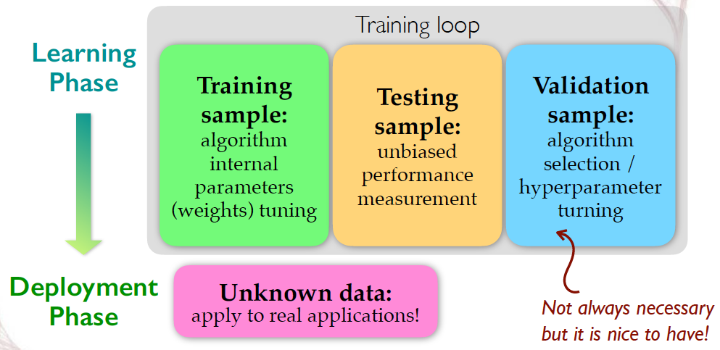
How to learn from data
We need indepedent data samples for training -> testing (-> validation) -> deployment
Courtesy of Prof. Kai-Feng Chen (NTU)

Slide 6
The ‘right’ questions to ask
In this course we focus on questions in physics. For example,
How to tell a signal event from a background event in particle experiments?
What is the true energy of a particle given the measurement made?
Which stars/objects belong to the same galaxy? What kind of galaxy?

Slide 7
The ‘right’ questions to ask
In this course we focus on questions in physics. For example,
How to tell a signal event from a background event in particle experiments? -> Classification
What is the true energy of a particle given the measurement made? -> Regression
Which stars/objects belong to the same galaxy? What kind of galaxy? -> Clustering, Dimensionality Reduction

Slide 8
The ‘right’ questions to ask
In this course we focus on questions in physics. For example,
How to tell a signal event from a background event in particle experiments? -> Classification Supervised learning
What is the true energy of a particle given the measurement made? -> Regression Supervised learning
Which stars/objects belong to the same galaxy? What kind of galaxy? -> Clustering, Dimensionality Reduction Unsupervised learning

Slide 9
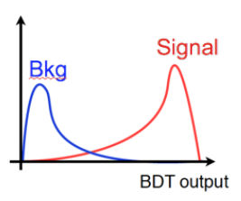
Supervised Learning
The right answer is given in the training data (‘labeled’)
E.g. Train a boosted decision tree (BDT) with data labeled as signal and background Classification: Discrete (True/False, Type I/II/III, etc.) prediction

Slide 10
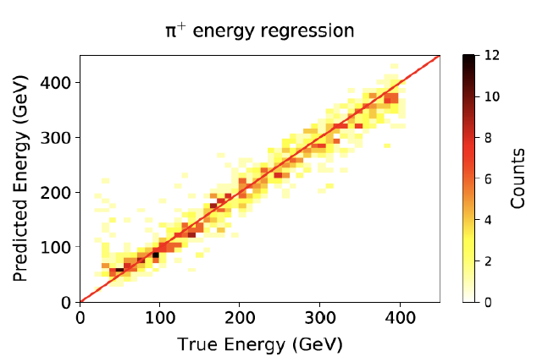
Supervised Learning
The right answer is given in the training data (‘labeled’)
E.g. Given the performance of the calorimeter, what is the true energy of a particle corresponding to a certain measured value.
Regression: continuous estimation

Slide 11
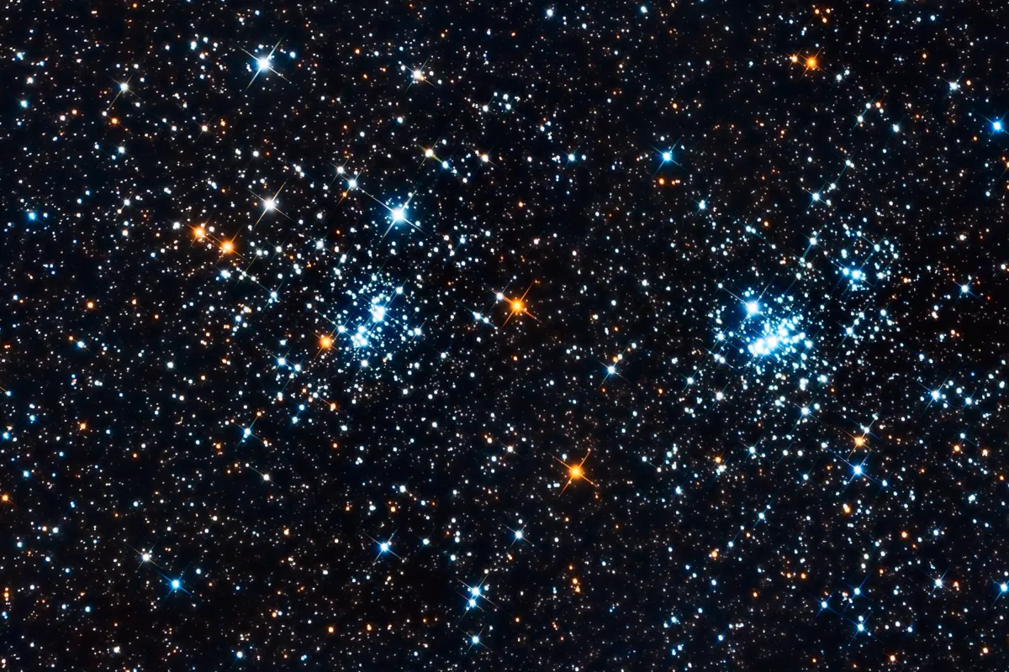
Unsupervised Learning
The right answer is not given in the training data (‘unlabeled’)
E.g. Given the observation, divide the stars into different groups
Clustering: The groups are not known beforehand

Slide 12
Unsupervised Learning
Unsupervised learning can help us find the hidden structure of the data in order to get meaningful insight
Group them according to similarity (Clustering)
Simplify the data by using a lower dimensional (less complex) representation -> Dimensionality reduction

Slide 13
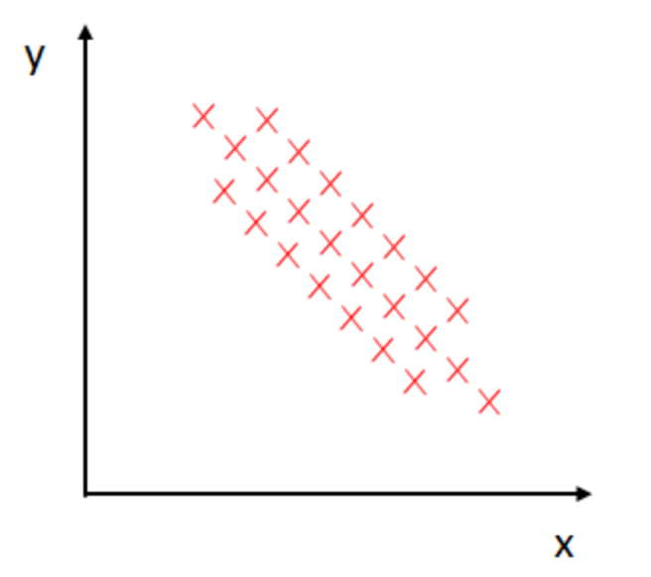
Dimensionality Reduction
Example: Principal Component Analysis (PCA)

Slide 14
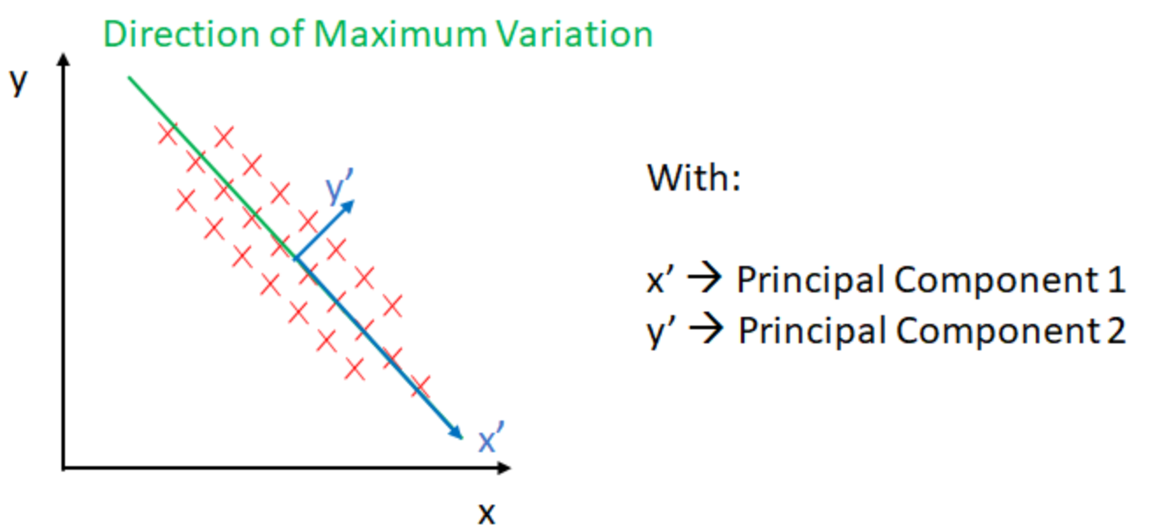
Dimensionality Reduction
Example: Principal Component Analysis (PCA)
https://towardsdatascience.com/unsupervised-learning-dimensionality-reduction-ddb4d55e0757

Slide 15
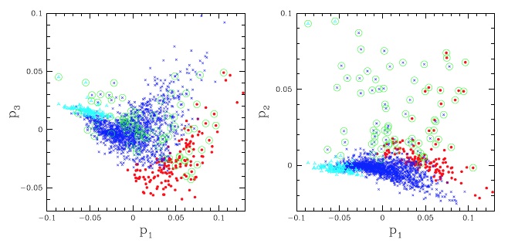
Dimensionality Reduction
Example: Reduce 14 parameters (properties) of galaxies into three major ‘eigenvectors’
arXiv:astro-ph/0610016

Slide 16
Summary
Machine learning is the field of training machines to perform tasks
Use independent data samples for training, testing, and validation.
Depending on the tasks it can be (roughly) categorized into
Supervised learning (with labeled data): Classification, Regression
Unsupervised learning (with unlabeled data): Clustering, Dimensional Dimensionality Reduction

Slide 17
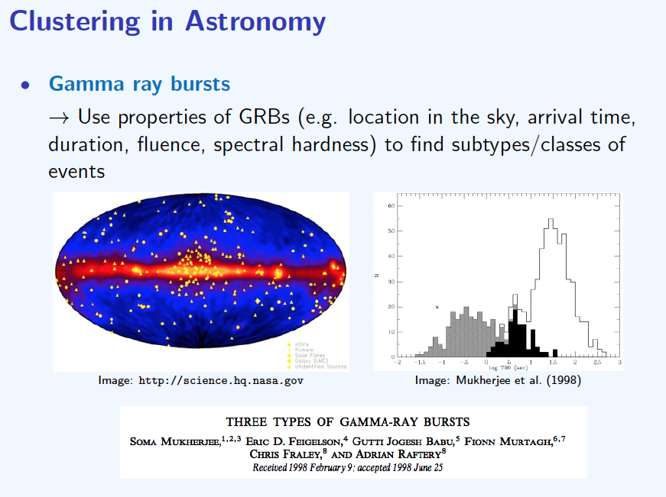
Pre-class Quiz
J. Cisewski (CMU), Clustering and Classification in Astronomy

Slide 18
In-class Quiz and Lab session:
Go to Slide 18 of this week’s slides. Click on the URL below for the Whiteboard and links to notebooks for today! In-class Whiteboard [URL]

